Slide 1
Wireless Sensor Networks

Slide 2
Objectives
To understand the fundamentals of wireless sensor networks and its application
To study the various protocols at various layers and its differences with traditional protocols
To understand the issues pertaining to sensor networks and the challenges involved in managing a sensor network

Slide 3
Syllabus
Introduction: Fundamentals of wireless communication technology, the electromagnetic spectrum radio propagation, characteristics of wireless channels, modulation techniques, multiple access techniques, wireless LANs, PANs, WANs, and MANs, Wireless Internet.
Introduction to adhoc/sensor networks: Key definitions of adhoc/ sensor networks, unique constraints and challenges, advantages of ad-hoc/sensor network, driving applications, issues in adhoc wireless networks, issues in design of sensor network, sensor network architecture, data dissemination and gathering.
MAC Protocols : Issues in designing MAC protocols for adhoc wireless networks, design goals, classification of MAC protocols, MAC protocols for sensor network, location discovery, quality, other issues, S-MAC, IEEE 802.15.4.
Routing Protocols: Issues in designing a routing protocol, classification of routing protocols, table-driven, on-demand, hybrid, flooding, hierarchical, and power aware routing protocols.
QoS and Energy Management : Issues and Challenges in providing QoS, classifications, MAC, network layer solutions, QoS frameworks, need for energy management, classification, battery, transmission power, and system power management schemes.

Slide 4
Books
Feng Zhao, Leonidas Guibas, “ Wireless Sensor Network”,Elsevier, 1st Ed. 2004
Kazem, Sohraby, Daniel Minoli, Taieb Zanti, “Wireless Sensor Network: Technology, Protocols and Application”, John Wiley and Sons 1st Ed., 2007
Wireless Sensor Networks by Raghavendra Sivalingam Znati/ Springer India
Jochen Schiller, "Mobile Communications", Pearson Education, 2nd Edition, 2003

Slide 5
Grading Criteria
Class discussion & attendance (10%)
Midterm presentations (10%)
Midterm paper (40%)
Final Exam (40%)

Slide 6
Introduction
sensor
A transducer
converts physical phenomenon e.g. heat, light, motion, vibration, and sound into electrical signals
sensor node
basic unit in sensor network
contains on-board sensors, processor, memory, transceiver, and power supply
sensor network
consists of a large number of sensor nodes
nodes deployed either inside or very close to the sensed phenomenon

Slide 7
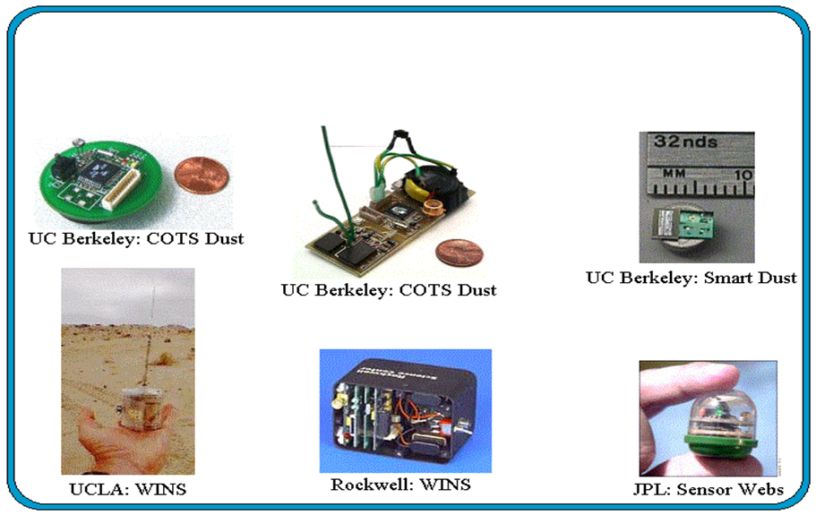
Modern Sensor Nodes

Slide 8
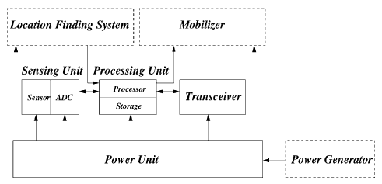
Sensor Node Components

Slide 9
Sensor Node Components
Sensing Unit
Processing Unit
Transceiver Unit
Power Unit
Location Finding System (optional)
Power Generator (optional)
Mobilizer (optional)

Slide 10
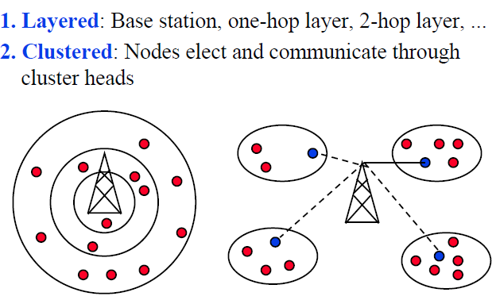
WSN Communication Architecture

Slide 11
WSN application types
Event detection: Nodes locally detect events (maybe jointly with nearby neighbors), report these events to
interested sinks
Periodic measurement
Function approximation: Use sensor network to approximate a function of space and/or time (e.g., temperature map)
Edge detection: Find edges (or other structures) in such a function (e.g., where is the zero degree border line?)
Tracking: Report (or at least, know) position of an observed intruder (“pink elephant”)

Slide 12
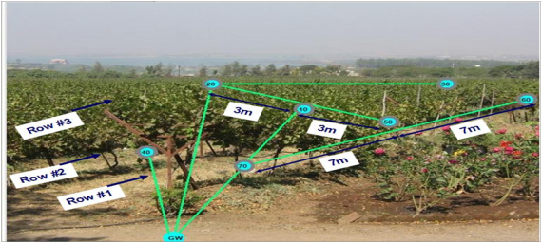
WSN application examples
Precision Agriculture
Source:AgriSens, NASHIK(India)

Slide 13
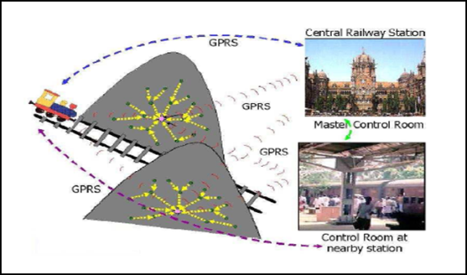
WSN application examples(Cont.)
Landslide Predictions

Slide 14
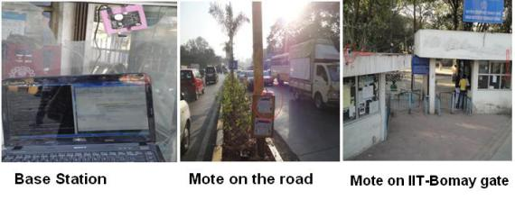
WSN application examples(Cont.)
Traffic monitoring
Source: SPANN Lab, IIT Mumbai

Slide 15
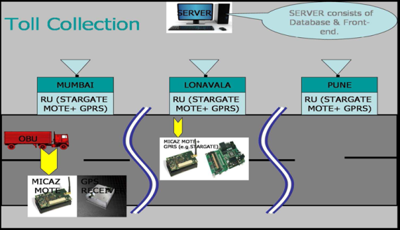
WSN application examples(Cont.)
Electronic toll collection
Source: SPANN Lab, IIT Mumbai

Slide 16
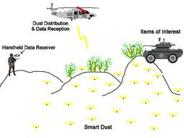
WSN application examples(Cont.)
Military applications

Slide 17
WSN application examples(Cont.)
Smart Home

Slide 18
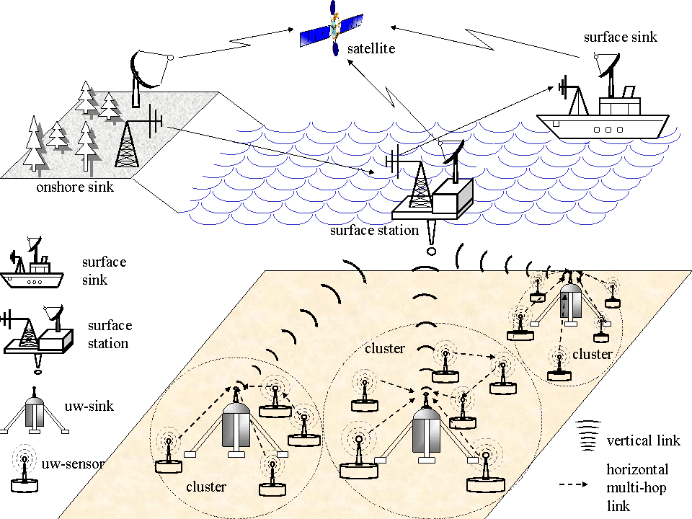
WSN application examples(Cont.)
Under water acoustic sensor network
Source: Georgia Institute of Technology

Slide 19
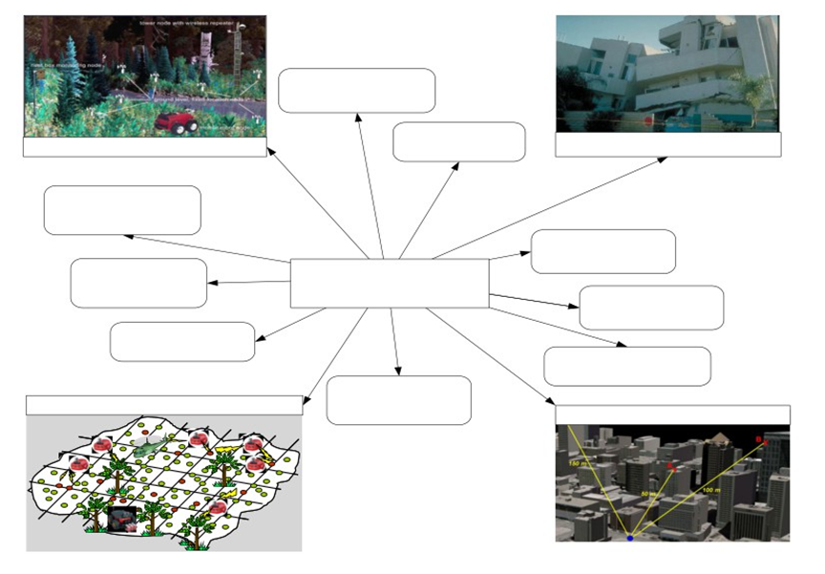
WSN applications spectrum
Interactive VR
Environmental Monitoring
Wearable
Disaster Recovery
Earth Science & Exploration
Context-Aware
Wireless Sensor Networks
Computing
Transportation
Biological Monitoring
Hazard
Detection
Environment Urban Warfare
Military Surveillance
Medical

Slide 20
Typical Features of WSN
A very large number of nodes, often in the order of thousands
Asymmetric flow of information, from the observers or sensor nodes to a command
Communications are triggered by queries or events
At each node there is a limited amount of energy which in many applications is impossible to replace or recharge
Almost static topology

Slide 21
Typical Features of WSN (Cont.)
Low cost, size, and weight per node
Prone to failures
More use of broadcast communications instead of point-to-point
Nodes do not have a global ID such as an IP number
The security, both physical and at the communication level, is more limited than conventional wireless networks

Slide 22
MANET vs. WSN
Many commonalities: Self-organization, energy efficiency, (often) wireless multi-hop
Many differences
Applications, equipment: MANETs more powerful (read: expensive) equipment assumed, often “human in the loop”-type applications, higher data rates, more resources
Application-specific: WSNs depend much stronger on application specifics; MANETs comparably uniform
Environment interaction: core of WSN, absent in MANET
Scale: WSN might be much larger (although contestable)
Energy: WSN tighter requirements, maintenance issues
Data centric vs. id-centric networking
Mobility: different mobility patterns like (in WSN, sinks might be mobile, usual nodes static)

Slide 23
IoT vs WSN
WSN sensors route their traffic to sink node, this node may be connected to Internet
IoT Sensors/nodes directly send their data on the internet
WSN most of data transmission is more than one-hop
IoT, one-hop transmission is preferred
WSN are application centric
IoT every node will have IP address
All of a WSN can be one node of IoT

Slide 24
Advantage of WSN
Due to multi hop communication, increased energy efficiency
Reduced SNR because of dense deployment
Notes:
Description in the notes

Slide 25
Key Terms
Sensor: A transducer that converts physical phenomenon (heat, light etc.) to electrical or other signal that may be further manipulated
Sensor node (Mote): Basic unit with sensor, processor, memory, power etc.
Network topology: A connectivity graph where nodes are sensor nodes and edges are communication links
Routing: Process of defining the network path from source node to its destination

Slide 26
Key Terms
Geographic Routing: Routing based on geographical attributes such as location or regions. This is an example of Data centric routing
Data Centric routing: The sink sends queries to particular regions and then looks for data from sensors located in that region. It is different from traditional routing in which routes are based on addressable nodes (Who’s temperature is more than 95 vs what is your temperature)

Slide 27
Key Terms
In-network processing: A style of processing in which data is processed and combined where it is generated.
System performance goal:
Scalability: WSNs have the potential to be large scale (Tens of thousands)
robustness: is a characteristic which ensures that system will perform as expected even in harsh or hostile environments
network longevity: How to increase the network lifetime.
Privacy and security (Difference???)
Privacy: Use personal information only for the purpose people approve for
Security: Prevent the information from being compromised through accident or malicious intent
Notes:
Evaluation metrices: Packet loss, network dwell time, false alarm rate, location error, processing latency
Privacy: Don’t do bad things with personal information. (Use personal information only for the purpose people approve for)
Security: Guard personal information so that others do not do bad things (Prevent the information from being compromised through accident or malicious intent)

Slide 28
Key Terms
Heterogeneity: Can be in terms of Computation, communication and Sensing. Challenge is to determine the right combination of heterogeneous devices
Notes:
If we have some devices with high power and some with low power than we can go for clustering or if devices have multiple sensing modalities then we need to go for fusion techniques

Slide 29
Network deployment
Given a set of sensors how and where should these nodes be deployed?
2 main factors:
Coverage: Application specific quantity of information obtained from environment by the networked sensor devices
Connectivity: Existence of path between every pair of nodes

Slide 30
Network deployment
Structured vs random deployment:
Place sink at a location that provides desired network and power connectivity
Place sensor nodes at location where measurements are needed
Random: Priori we can decide location of devices. Post deployment self configuration mechanism Is needed

Slide 31
Network topology
Single-hop (Star topology) : Every node communicates with central sink
Limitations???
Multi-hop mesh and Grid: nodes form arbitrary mesh graphs.
Clustered topology: Multiple nodes within each cluster report to different cluster heads
Advantages?
Large n/w is decomposed into small n/ws so local processing is possible
Notes:
Poor scalability and robustness (limitation of star topology)

Slide 32
Protocols for WSN
802.15
Standard specifies WPANs for different applications
802.15.4:
Provides a standard with ultra-low complexity, cost and power for low-data rate wireless connectivity among inexpensive fixed, portable and moving devices

Slide 33
IEEE 802.15.4 vs Zigbee
802.15.4 : PHY and MAC layer
Zigbee: N/w to Application Layer

Slide 34
Required mechanisms
Multi-hop wireless communication
Energy-efficient operation
Both for communication and computation, sensing, actuating
Auto-configuration
Manual configuration just not an option
Collaboration & in-network processing
Nodes in the network collaborate towards a joint goal Pre-processing data in network can greatly improve efficiency

Slide 35
Required mechanisms (Cont.)
Data centric networking
Focusing network design on data, not on node identifies (id- centric networking)
Locality
Do things locally (on node or among nearby neighbors) as far as possible
Exploit tradeoffs
E.g., between invested energy and accuracy

Slide 36
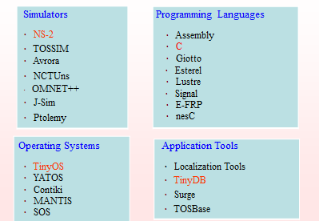
WSN Open Source Tools

Slide 37
Lab Assignment-1
Introduction to network simulation through the OMNET++
What is OMNET++?
What is a network?
What is a simulation?
What does OMNET++ provide?

Slide 38
Lab Assignment-2
Design and configure a simple network model, collect statistics and analyze network performance
Network topology
Scenario (interaction between i/p data and o/p data)
Network parameters (simulation time, frames generated, protocols used etc)
Network performance metrics (throughput, frames dropped, etc.)

Slide 39
List of Lab Experiments
Introduction of Wireless sensor network applications and its simulation.
Network Simulator installation of wireless sensor network.
Write TCL script for transmission between mobile nodes.
Write TCL script for sensor nodes with different parameters.
Generate tcl script for udp and CBR traffic in WSN nodes.
Generate tcl script for TCP and CBR traffic in WSN nodes.
Implementation of routing protocol in NS2 for AODV protocol.
Implementation of routing protocol in NS2 for DSR protocol.
Implementation of routing protocol in NS2 for TORA protocol.
Study other wireless sensor network simulators (Mannasim. Contiki.)

Slide 40
Introduction to network simulators used for wireless Ad-Hoc and Sensor Networks.
2. Introduction to TCL scripting: demonstration of one small network simulation script.
3. To study various trace file formats of network simulators.
4. To implement and compare various MAC layer protocols.
5. To implement and compare AODV and DSR routing algorithms in MANET.
6. To implement DSDV routing algorithms in MANET.
7. To implement signal strength based link management routing protocols.
8. To calculate and compare average throughput for various TCP variants.
9. To implement and compare various routing protocols for wireless sensor networks.
10. To study Ethereal / Wireshark software and analyze dump files.
11. Seminar.
12. Mini project based on simulation.

Slide 41
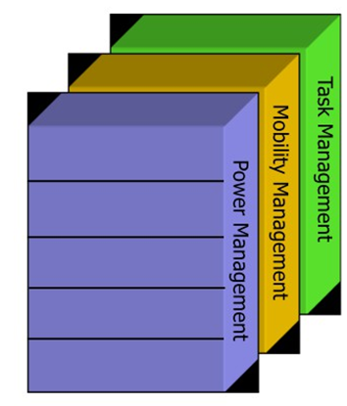
WSN Protocol Stack (Cont.)
Power Management - How the sensor uses its power, e.g. turns off its circuitry after receiving a message.
Mobility Management - Detects and registers the movements of the sensor nodes
Task Management - Balances and schedules the sensing tasks given to a specific region
Application Transport
Network
Data Link
Physical
Source: Lindsey, Sivalingam, and Raghavendra book chapter in Wiley Handbook of Mobile Computing, Ivan Stojmenovic, Editor, 2002.

Slide 42
WSN Protocol Stack
Physical layer
Low power circuit(CMOS, ASIC) design
Optimum hardware/software function division
Energy effective waveform/code design
Adaptive RF power control
MAC sub-layer
Energy effective MAC protocol
Collision free, reduce retransmission and transceiver on-times
Intermittent, synchronized operation
Rendezvous protocols
Link layer
FEC versus ARQ schemes; Link packet length adapt.
Network layer
Multi-hop route determination
Energy aware route algorithm
Route cache, directed diffusion
Application layer
Video applications: compression and frame-dropping
In-network data aggregation and fusion

Slide 43
Data-Centric Routing
Interest dissemination is performed to assign sensing tasks to sensor nodes
Sinks broadcast the interest
Sensor nodes broadcast an advertisement for available data
Requires attribute-based naming
Users are more interested in querying the attribute of the phenomenon, rather than querying an individual node
E.g. the sensor nodes in the area where temperature is greater than 75 F

Slide 44
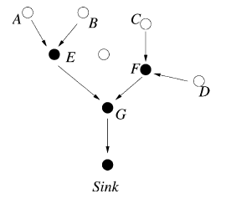
Data Aggregation in WSNs
Data coming from multiple sensor nodes are aggregated if they are about the same attribute of the phenomenon when they reach the same routing node on the way back to the sink
Solves implosion and overlap problem
Energy efficient

Slide 45
Data Dissemination
Flooding
Sensor broadcasts every packet it receives
Relay of packet till the destination or maximum number of hops
No topology maintenance or routing
Gossiping
Enhanced version of flooding
Sends received packet to a randomly selected neighbor

Slide 46
Research issues
Location Discovery
Quality of a Sensor Network
Real-Time Communication
Layer Wise Issues

Slide 47
Real Time Communication
Real-Time Communication using deadline based forwarding

Slide 48
Conclusion
WSNs possible today due to technological advancement in various domains
Envisioned to become an essential part of our lives
Design Constraints need to be satisfied for realization of sensor networks
Tremendous research efforts being made in different layers of WSNs protocol stack

Slide 49
Paper Reviews and Presentations
Students are required to read, present, and discuss research papers. An average of 2-3 papers per week will be read. For each paper, students should write a review answering each of the following questions:
What problems (with prior work or the lack thereof) were addressed or surveyed by the authors?
What solutions were proposed or surveyed by the authors?
What are the technical strengths and main contributions of the paper's proposed solutions?
What are the technical weaknesses of the paper's proposed solutions? What suggestions do you have to improve upon the paper's ideas?
Each paper to be discussed in class will be assigned to a group of students to present in class.

Slide 50
References
I. F. Akyildiz, W. Su, Y. Sankarasubramaniam, and E. Cayirci, “Wireless Sensor Networks: A Survey”, Elsevier Computer Networks, volume 38, Issue 4, pp. 393-422, March 2002.
Dr. Victor Leung, Lecture Slides on “Wireless Sensor Networks”, University of British Columbia, Canada
D. Curren, “A Survey of Simulation in Sensor Networks”
Wikipedia, [Available Online] http://en.wikipedia.org/wiki/Wireless_Sensor_Networks

Slide 51
References
Dr. Chenyang Lu Slides on “Berkeley Motes and TinyOS”, Washington University in St. Louis, USA
J. Hill and D. Culler, “A Wireless Embedded Sensor Architecture for System-Level Optimization”, Technical Report, U.C. Berkeley, 2001.
X. Su, B.S. Prabhu, and R. Gadh, “RFID based General Wireless Sensor Interface”, Technical Report, UCLA, 2003.

Slide 52
Thank you!

Slide 53
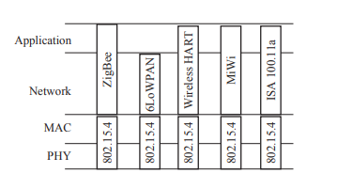
802.15.4
Used by several “Internet of Things” protocols: ZigBee, 6LowPAN, Wireless HART, MiWi, and ISA 100.11a
Uses the concept of spread spectrum as 802.11

Slide 54
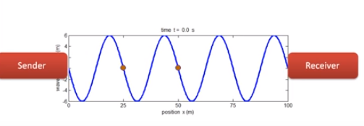
Conventional Networking
In conventional wireless network fixed frequency is used and this frequency does not change over time.
For example for listening to the video we tune to the fixed frequency such as 93.5 FM.

Slide 55
Conventional Networking
Interference: Another signal may be transmitted on or very near frequency of the desired signal. It may be deliberate or accidental.
Interception: A constant frequency is easy to intercept
Also known as Narrowband Signal
Requires lots of power
Jamming is also easier:
Notes:
most radio users use the term "jamming" to describe the deliberate use of radio noise or signals in an attempt to disrupt communications (or prevent listening to broadcasts) whereas the term "interference" is used to describe unintentional forms of disruption (which are far more common).

Slide 56
Spread Spectrum Technology
Apply techniques to deliberately spread the spectrum of the original signal
New signal with wider bandwidth
Reduced interference
Immunity to Jamming
Secure
Low power consumption

Slide 57
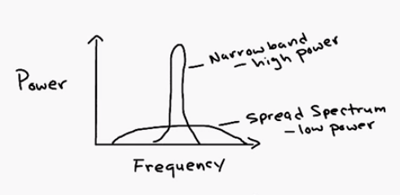
Spread Spectrum Technology
Example: To transmit 1 Mhz using narrowband might require 10 Watt while 20 Mhz can be transmitted using 10mw in case of spread spectrum

Slide 58
Uses of Spread Spectrum
Works in ISM band (902-928Mhz, 2400-2483.5Mhz, 5752-5850 Mhz)
Wireless LAN (Local Area Networks) widely use spread spectrum communications. IEEE 802.11 is a standard that is developed for mobile communication, and widely implemented throughout the world. The standard defines three types of Physical Layer communications. These are:
Infrared (IR) Communications
Direct Sequence Spread Spectrum Communications
Frequency Hopping Spread Spectrum Communications.
Among the three, DSSS, and FHSS are widely used.

Slide 59
Uses of Spread Spectrum
Cordless Phones
Cellular base stations interconnection
Military communications

Slide 60
Spread Spectrum
Frequency Hopping (FHSS)
Direct Sequence (DH-SS)

Slide 61
Frequency Hopping SS
Carrier signal frequency changed (hopped)
Predetermined sequence(hopping pattern)
Pseudorandom sequence known to both transmitter and receiver
For example
2.449GHZ, 2.452GHz, 2.448GHZ, 2.440GHZ

Slide 62
Frequency Hopping Systems
Channel: Specific Hop patterns. FCC allows 26 different hop patterns
Dwell Time: transmit time on a particular frequency (300 ms in IEEE 802.11)
Hope time: a very small amount of time during a frequency change for which the radio is not transmitting
Dwell interval≤ Hop interval
Available radio frequency spectrum (band) – Divided into q sub-bands (frequency#slots)

Slide 63
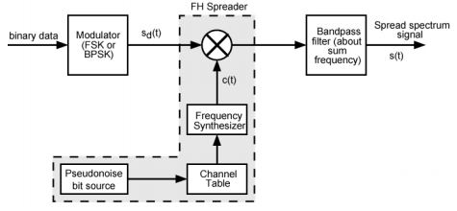
FHSS (Sender)

Slide 64
Pseudorandom Numbers
Generated by algorithm using initial seed
Deterministic algorithm
Not actually random
If algorithm good, results pass reasonable tests of randomness
Need to know algorithm and seed to predict sequence
Hence only receiver can decode signal

Slide 65
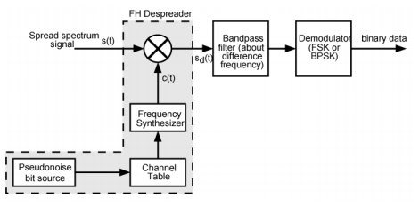
FHSS (Receiver)

Slide 66
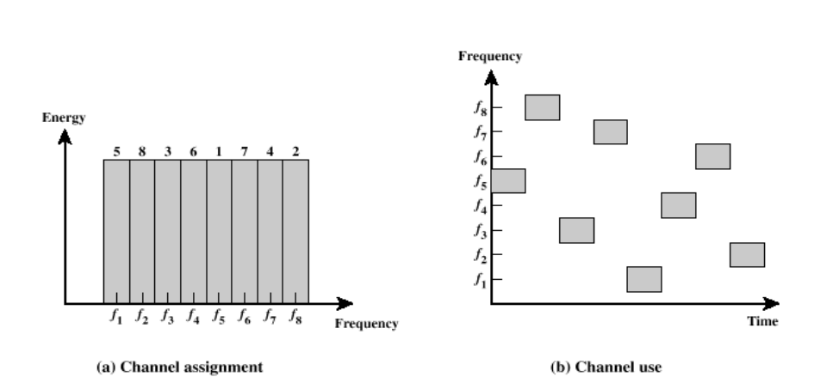
FHSS
A spreading code dictates the sequence of channels used.
There are 2^{k} carrier frequencies forming 2^{k} channels. Here k=3

Slide 67
FHSS
Receiver hops between frequencies in sync with transmitter
Eavesdroppers hear unintelligible blips
Jamming on one frequency affects only a few bits

Slide 68
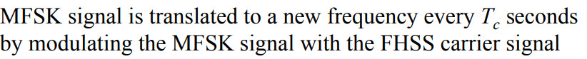
Slow and Fast FHSS
FHSS commonly uses multiple FSK (MFSK)
Frequency shifted every T_{c} seconds (Dwell time)
Duration of signal element is T_{s} seconds
Slow FHSS has T_{c} ≥ T_{s} (popular in Wireless LAN)
Fast FHSS has T_{c} < T_{s}
Generally fast FHSS gives improved performance in noise (or jamming)
Notes:
Tc ≥ Ts - slow-frequency-hop spread spectrum o Cheaper to implement but less protection against noise/jamming o Popular technique for wireless LANs  Tc < Ts - fast-frequency-hop spread spectrum o More expensive to implement, provides more protection against noise/jamming

Slide 69
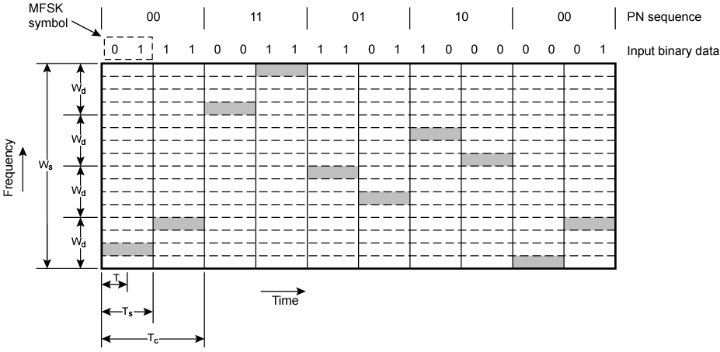
Slow Frequency Hop Spread Spectrum Using MFSK (M=4, k=2)
T=bit time
T_{s} = duration of signal element
T_{c} = frequency shift time
M (M=4) different frequencies are used to encode log₂(M) = 2 data bits
Each channel has total bandwidth W_{d} = M×f_{d}, f_{d}= difference frequency
FHSS uses 2^{k} different channels (k = 2), total bandwidth W_{s}= 2^{k}×W_{d}
Each 2 bits of PN sequence is used to select one of the four channels

Slide 70
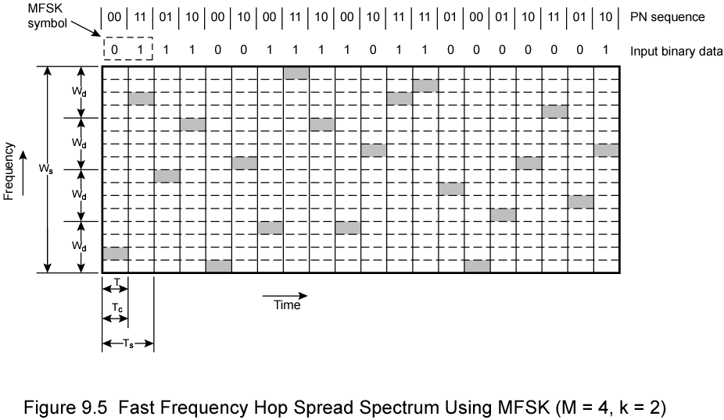
Fast Frequency Hop Spread Spectrum Using MFSK (M=4, k=2)
T=bit time
T_{s} = duration of signal element
T_{c} = frequency shift time
M (M=4) different frequencies are used to encode log₂(M) = 2 data bits
Each channel has total bandwidth W_{d} = M×f_{d}, f_{d}= difference frequency
FHSS uses 2^{k} different channels (k = 2), total bandwidth W_{s}= 2^{k}×W_{d}
In this case, each signal element is represented by two frequency tones and T_{s} = 2T_{c} = 2T

Slide 71
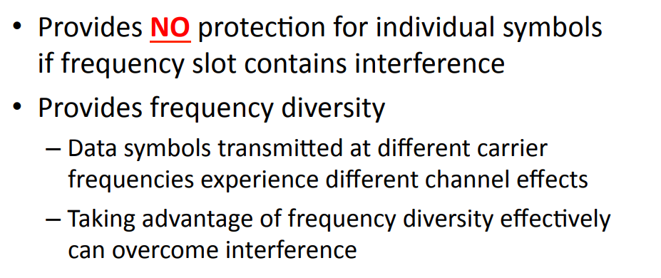
Good vs Bad for FHSS

Slide 72
Direct Sequence Spread Spectrum (DSSS)
Every user is assigned a spreading code and this is used to spread the signal
Each bit represented by multiple bits using spreading code
Spreading code spreads signal across wider frequency band
In proportion to number of bits used
10 bit spreading code spreads signal across 10 times bandwidth of 1 bit code
One method:
Combine input with spreading code using XOR
Input bit 1 inverts spreading code bit
Input zero bit doesn’t alter spreading code bit
Data rate equal to original spreading code
Performance similar to FHSS

Slide 73
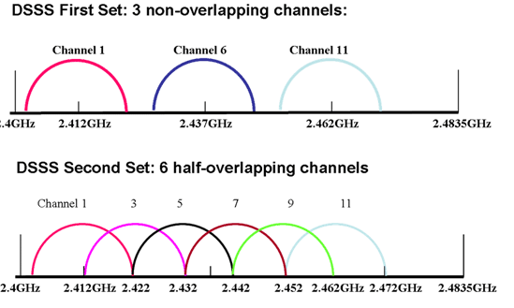
DSSS Channels
Each channel is continuous band of frequencies 22 Mhz wide
Channel 1 operates from 2.401 to 2.423 Ghz
Channels are displayed at their center point 2.412Ghz, +11 and -11
Notes:
If we want to have more than one wireless access point in the vicinity, their channels should not be overlapped

Slide 74
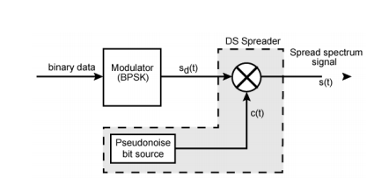
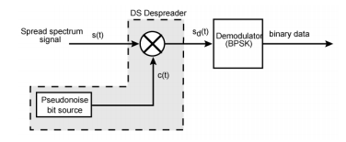
DSSS
Transmitter and Receiver

Slide 75
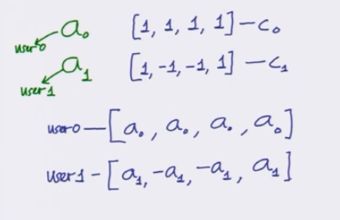

DSSS example

Slide 76
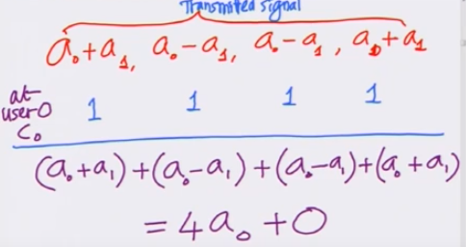
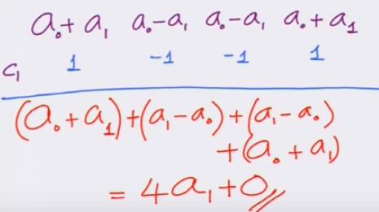
DSSS Example
Receiver side

Slide 77
Key operations
Multiplication with code
Combine the signals of all the users
Correlate with the code (at receiver)

Slide 78
DSSS
C₀ = [1,1,1,1]
C₁= [1,-1,-1,1]
When you multiply these codes:
1+(-1)+(-1)+1 =0
These codes are orthogonal to each other.
C_{0,} C₁ are spreading codes

Slide 79
Why it is known as spreading codes
Assume: Data transmission rate for a₀ is 1 kbps
Time per symbol is T= 1/1 kbps = 1 ms
Bandwidth required for this transmission is:
1/T=1/ 1 ms = 1 Khz
Now in CDMA instead of transmitting a₀ only we are transmitting: [a_{0,} a_{0,} a_{0,} a₀]
Earlier the time per symbol was 1 ms now we are transmitting 4 symbols in 1 ms => ¼ =0.25 ms so bandwidth required for this transmission:
1/.25 = 4 KHz
Multiplication with code has spread the bandwidth of the original signal

Slide 80
Signal Speading
In previous example Bandwidth spread by 4 times so
Bandwidth spread occurs as per the length (No. of bits) of the spreading sequence =N
With length 4 we have 4 different orthogonal codes:
C₀ = [1,1,1,1]
C₁= [1,-1,-1,1]
C₂ = [1,-1,1,-1]
C₃= [1,1,-1,-1]
Number of orthogonal channel corresponding to length N is N hence number of users that can access the common channel is also N
Notes:
By increasing the code length more number of users can be supported

Slide 81
DSSS
C₁= [1,-1,-1,1] looks like a random sequence of +1, -1
though not fully random so it is known as “Pseudo Noise”
Or PN sequence
One of the method to generate this PN sequence is
LFSR (Linear Feedback Shift Register)
CDMA is a multiplexing technique with spread spectrum
Notes:
For CDMA application, each mobile user uses one sequence in the set as a spreading code • Provides zero cross correlation among all users

Slide 82
Assignment
List 3 benefits of spread spectrum technology

Slide 83
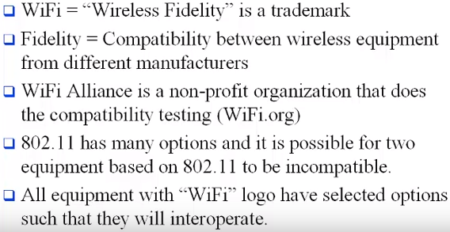
802.11 vs Wi-Fi
802.11 is a standard

Slide 84
Wi-fi interference
Co-channel interference: Use more than one access point on the same channel in the same physical are
Cross channel interference: use of overlapping channels for transmission
Non Wi-Fi interference: garage remote, microwave owen etc.

Slide 85
802.11
It works in ISM band (2.4 Ghz and 5Ghz)
14 channels in 2.4 GHz
Only 11 are used (12,13,14 are reserved)
Each channel is 22 Mhz wide
But their center frequency is 5 Hz apart only
Channels overlaps
In 5 GHZ , 12 non-overlapping channels
Which one is good, 2.4 or 5 Ghz??

Slide 86
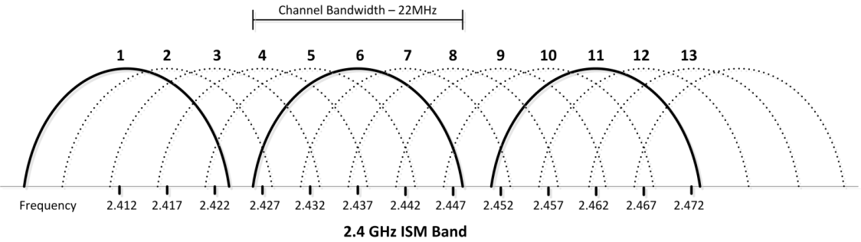
802.11
Only 3 non-overlapping channels are available

Slide 87
802.11
2.4 Ghz | 5 Ghz
The band is a pretty crowded place, because it’s used by more than just Wi-Fi. Old cordless phones, garage door openers, baby monitors, and other devices tend to use the 2.4 GHz band. Resulting congestion can cause dropped connections and slower-than-expected speeds. | 5GHz operates on a larger spectrum with more non overlapping channels.
It can easily pass through obstacles | Its hard to pass obstacles

